Slide 1
Amazon Movies & TV Reviews Database Analysis
Ho Man Leung, Drazen Zack & Arthur Bertrand

Slide 2
Analyzing reviews using Natural Language Processing (NLP)
Exploratory Data Analysis (EDA)
Data Processing
Implementing Algorithms
Validation
Testing your Model

Slide 3
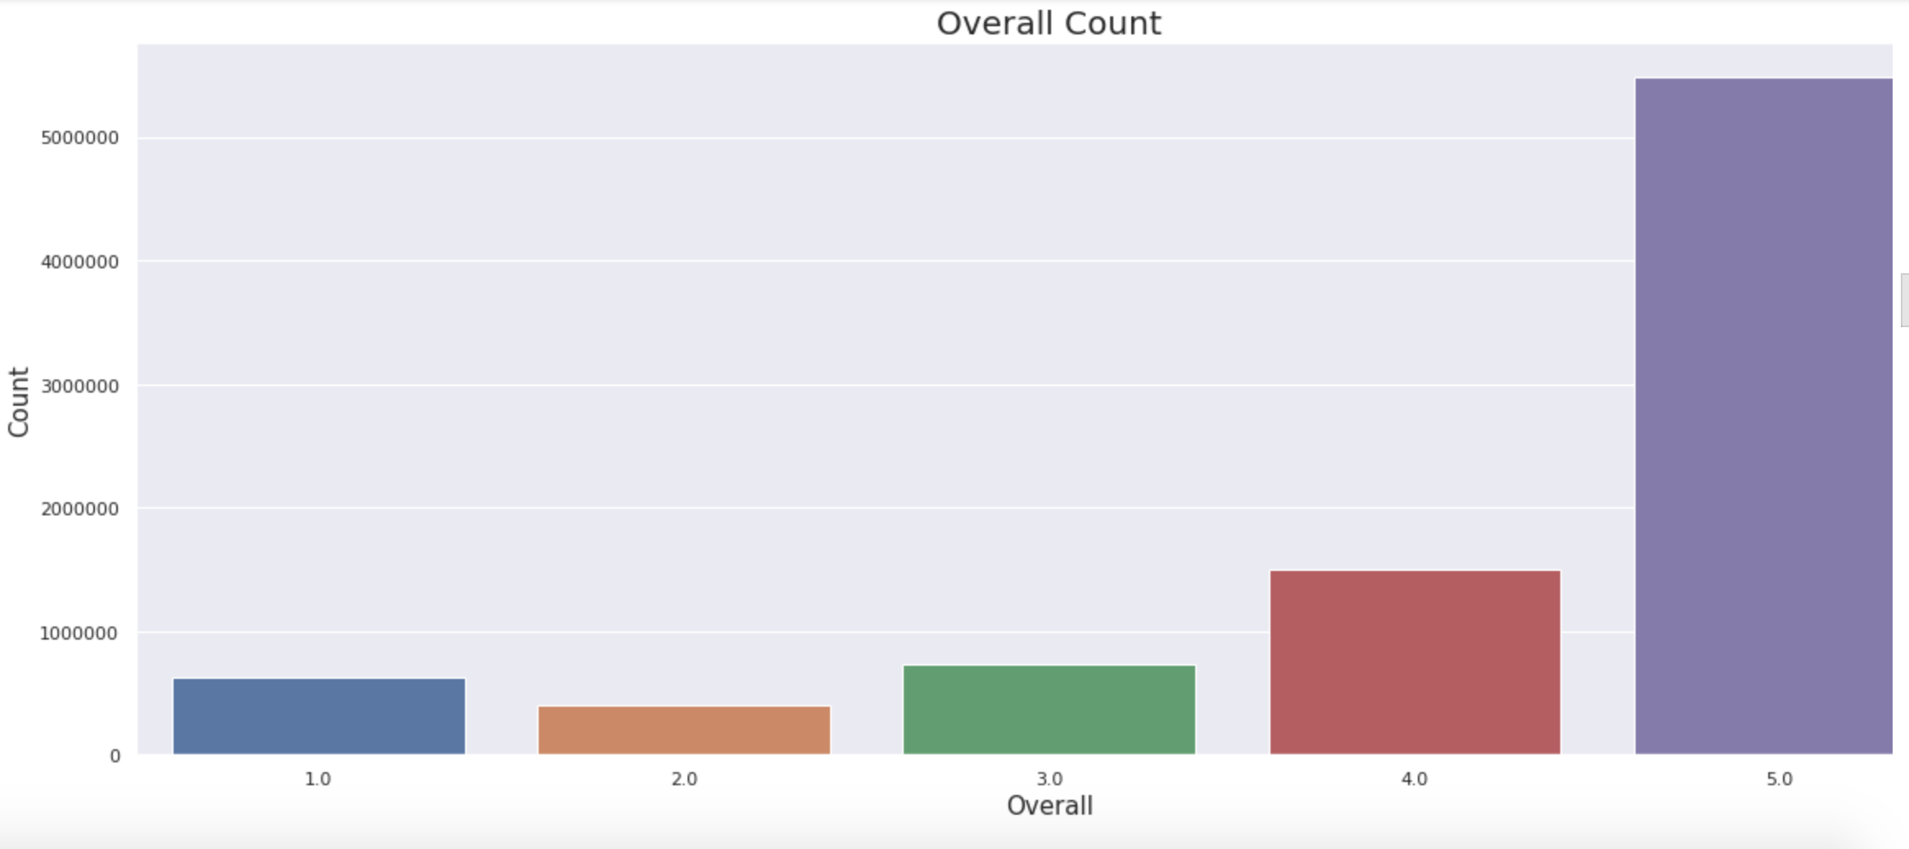
Exploratory Data Analysis (EDA)
Overall Representation of the Data

Slide 4
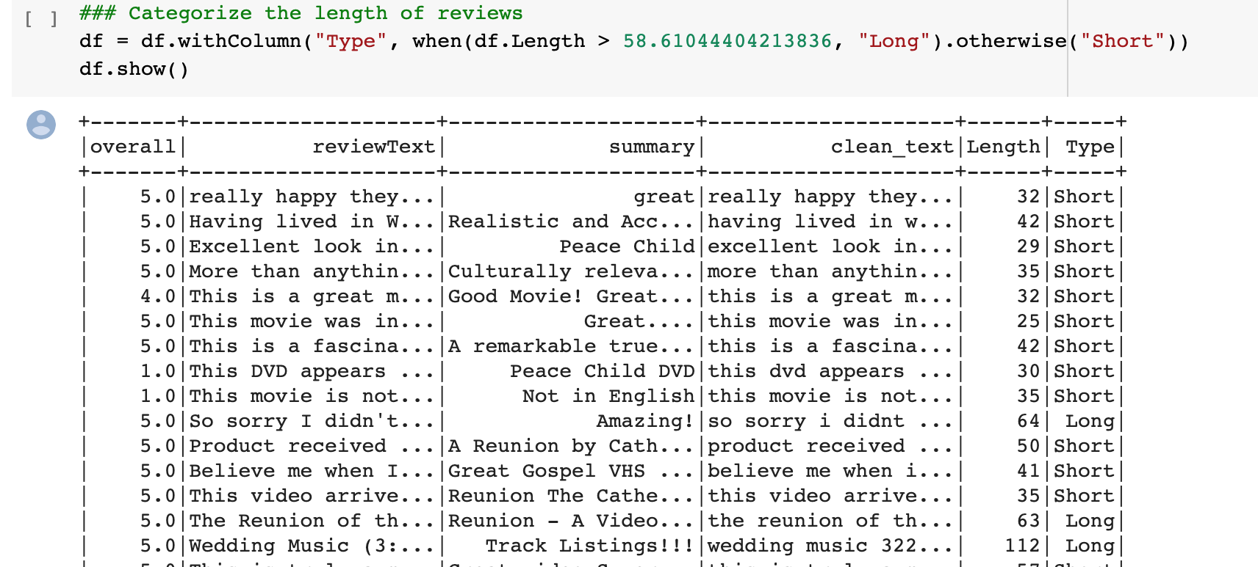
B. Categorize the Length of the Data

Slide 5
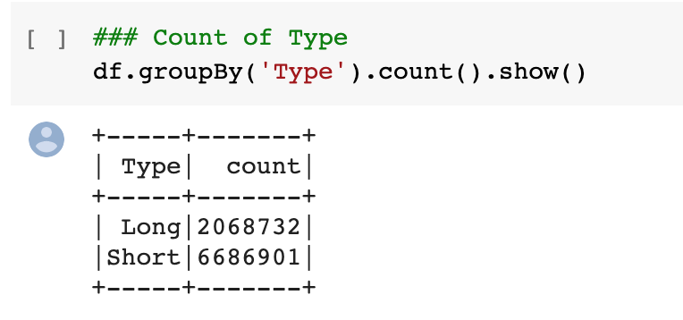
B. Length of the Data -- Results

Slide 6
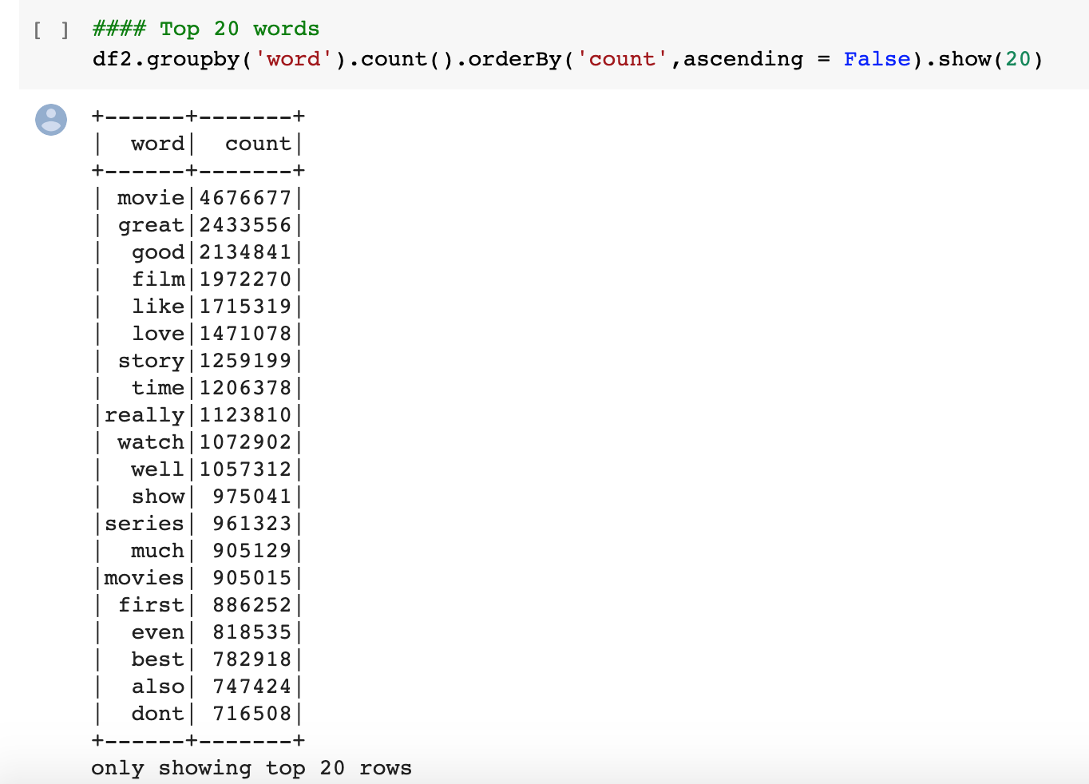
C. Most Common Words in the Data Set

Slide 7
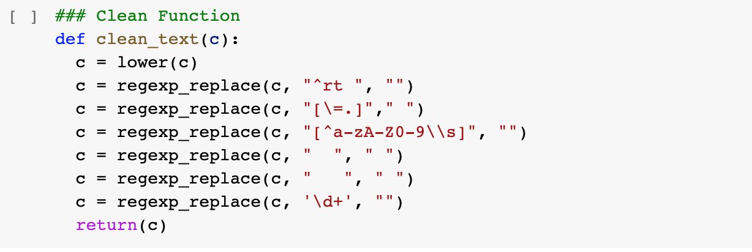
2. Data Processing
A & B. Remove Punctuations & Special Characters & Lowercase Words

Slide 8
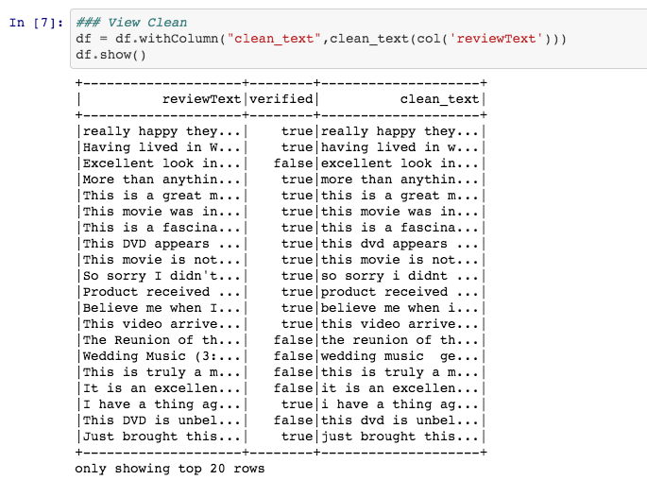
A & B. Results

Slide 9
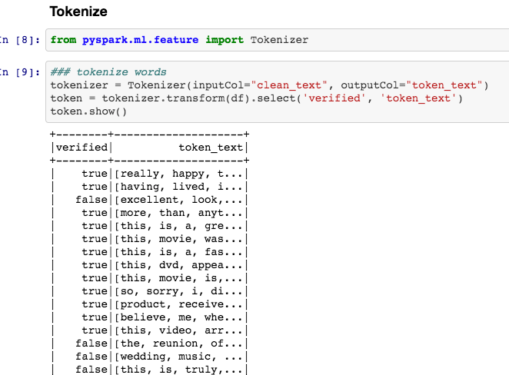
C. Tokenizer & Remove Stop Words

Slide 10
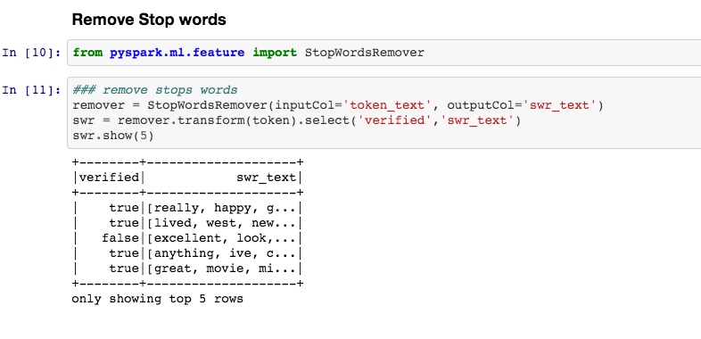
C. Tokenizer & Remove Stop Words (part 2)

Slide 11
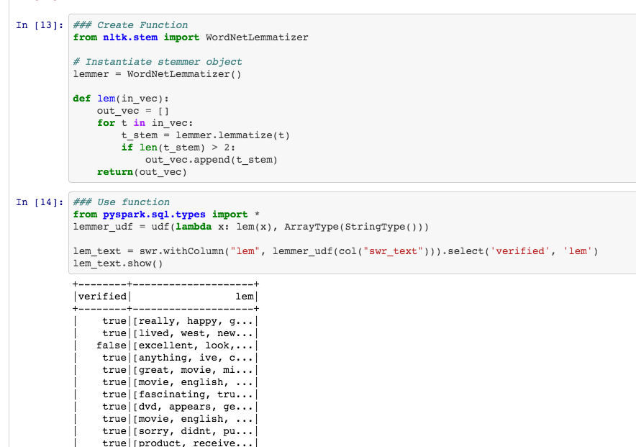
D. Lemmatization

Slide 12
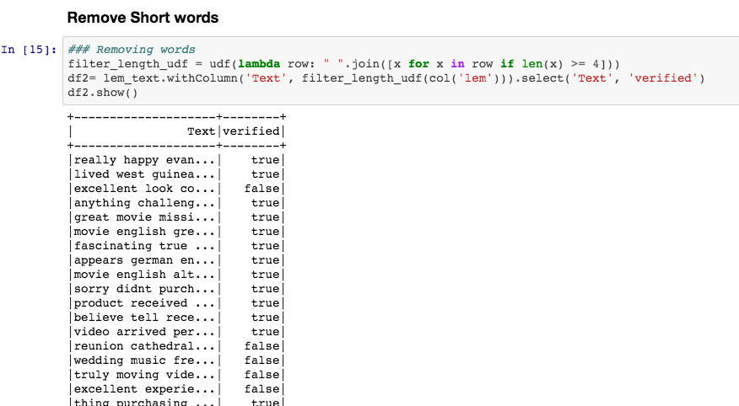
E. Removing Short Words

Slide 13
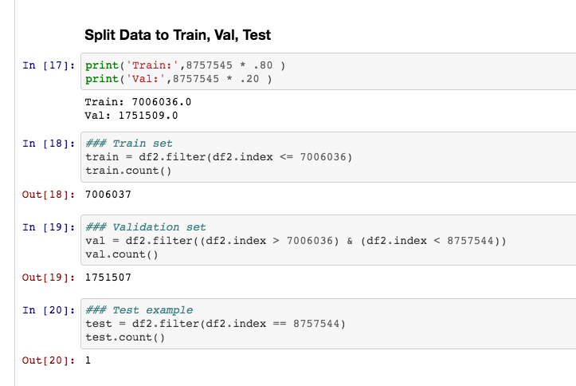
F. Split data into Train, Validation, Test

Slide 14
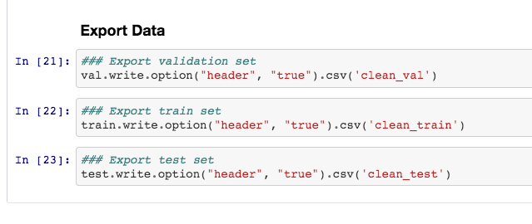
F. Export Train, Validation, Test

Slide 15
3. Machine Learning

Slide 16
4. Validation

Slide 17
5. Testing

